Slide 1
Housing Project

Slide 2
AGENDA
Problem Statement
Problem Framing
Data Preparation
Exploratory Data Analysis
Visualization
Analysis
Model Building
Saving the Model
Conclusion

Slide 3
PROBLEM STATEMENT
A house is something that every human needs and this market is one of the top markets that contributes to the global economy.
A US-based housing company named Surprise Housing has decided to enter the Australian market. The company uses data analytics to purchase houses at a price below their actual values and flip them at a higher price. For the same purpose, the company has collected a data set from the sale of houses in Australia.
The company is looking at prospective properties to buy houses to enter the market. You are required to build a model using Machine Learning in order to predict the actual value of the prospective properties and decide whether to invest in them or not. For this company wants to know:
Which variables are important to predict the price of variable?
How do these variables describe the price of the house?

Slide 4
PROBLEM FRAMING
In this Machine Learning project, I will be predicting the sale price of the houses in Australian region using the provided dataset
The Surprise Housing company expects us to predict the sale price of the house along with the important variables which helps in prediction of the same
Further, we will also learn on how these variables describe the sale price of the house
The provided dataset consists of 1460 rows and 81 features (including train and test dataset)

Slide 5
DATA PREPARATION
There are missing data in some of the variables which needs to be handled & categorical column also needs to be converted into numerical column.
We can fill null values of categorical columns with 0 as it basically represents that, the feature is not available for the property.
For missing values in numerical column, we can fill them mode of the respective column.
Next step is to assign every categorical data a unique value.
With this the data-frame has been cleaned and transformed properly for us to start analysing.

Slide 6
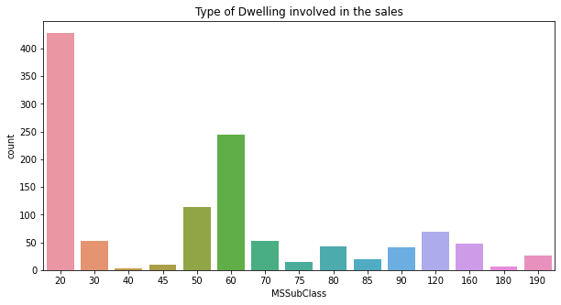
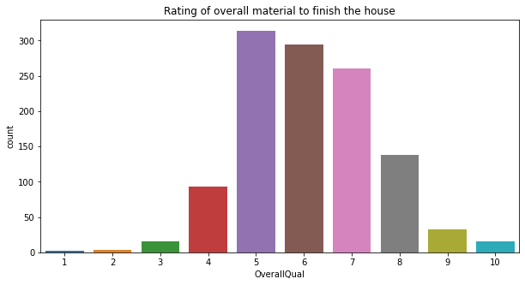
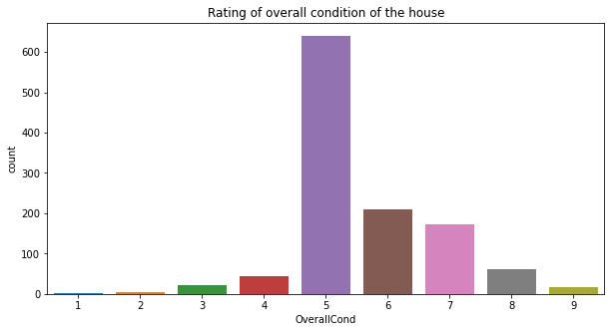
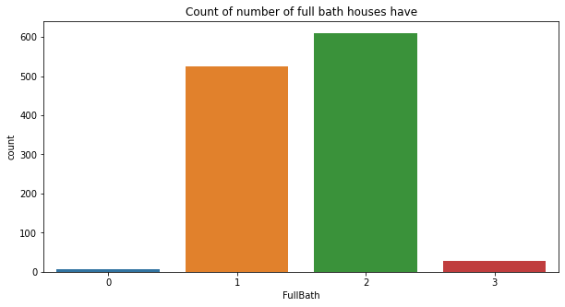
VISUALIZATION

Slide 7
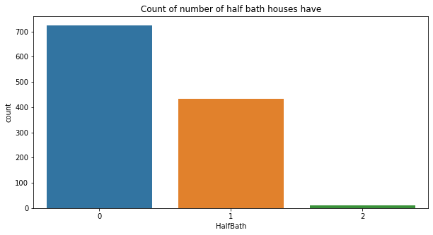
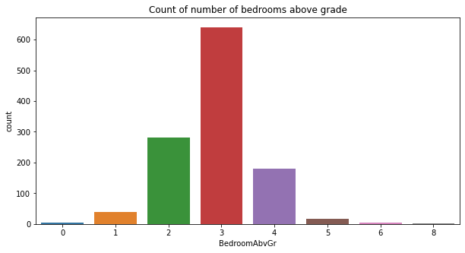
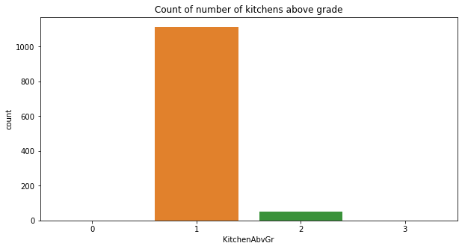
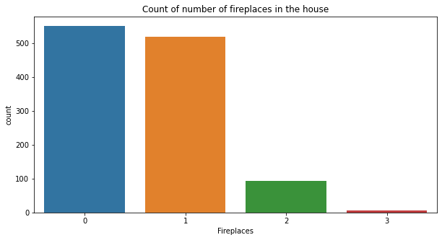

Slide 8
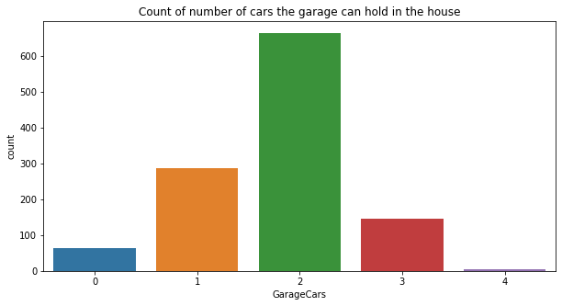
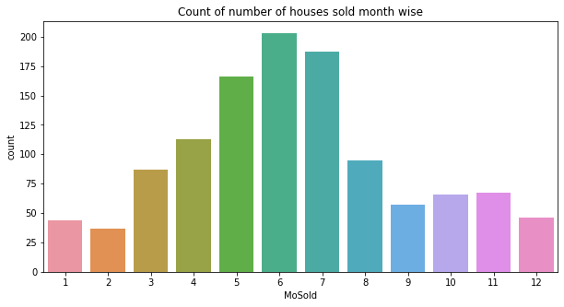
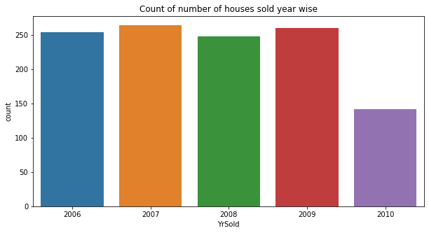
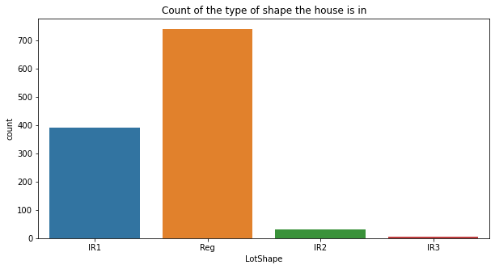

Slide 9
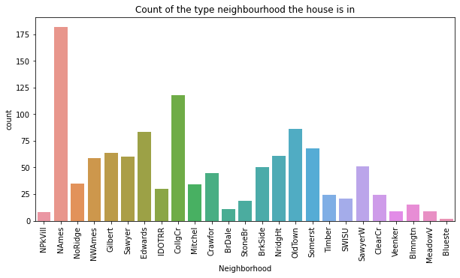
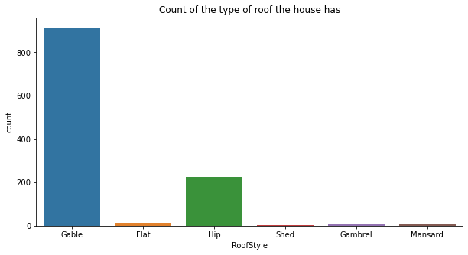
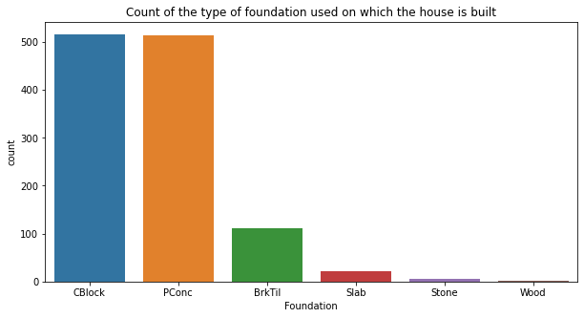
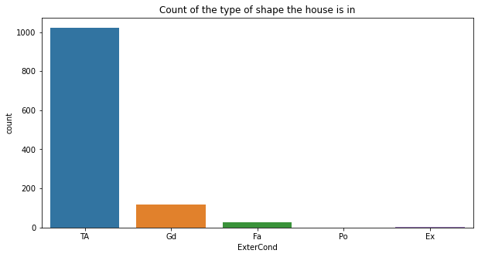

Slide 10
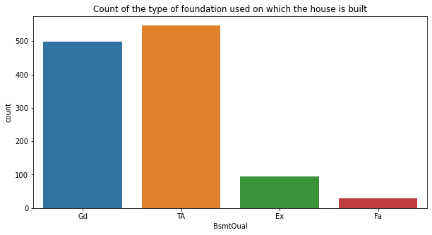
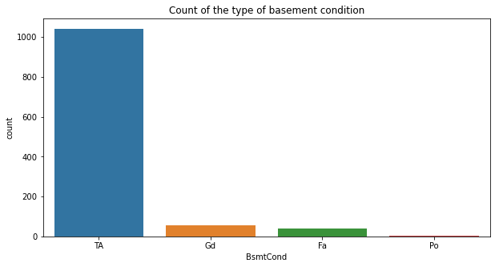
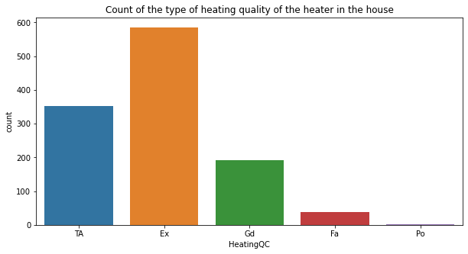
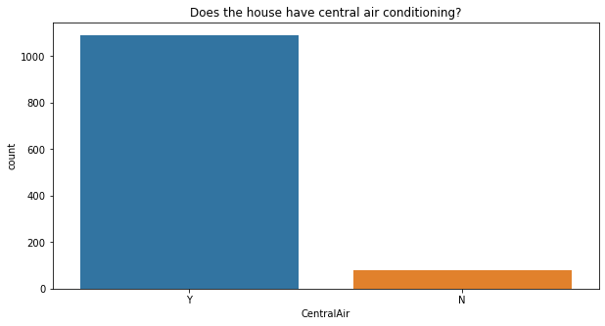

Slide 11
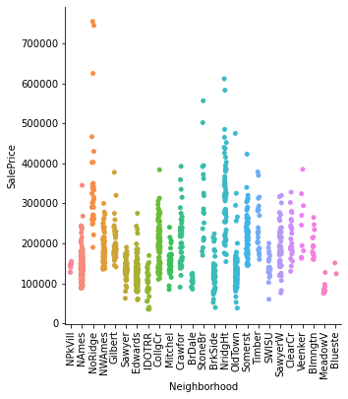
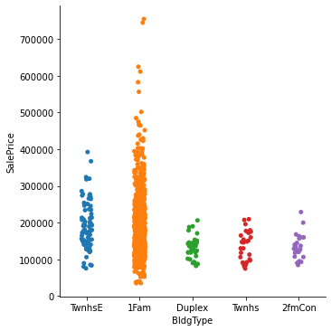
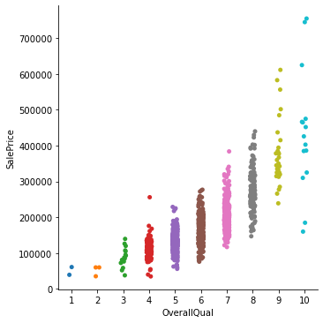
Bivariate Analysis

Slide 12
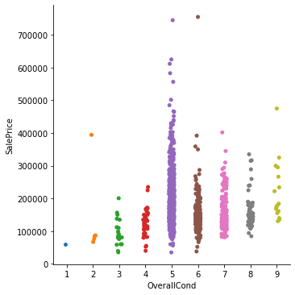
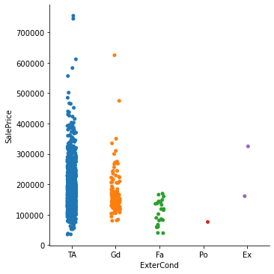
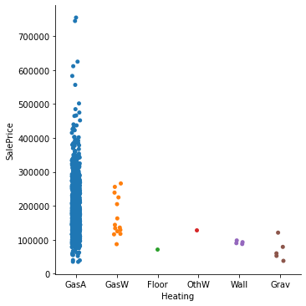

Slide 13
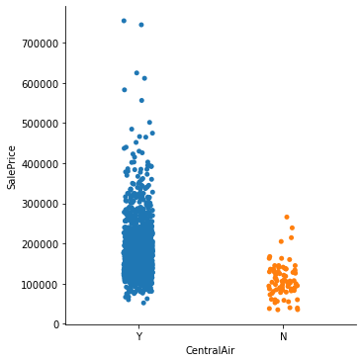
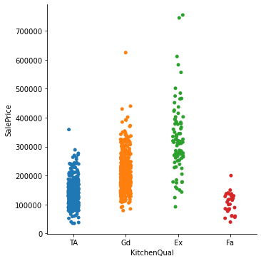
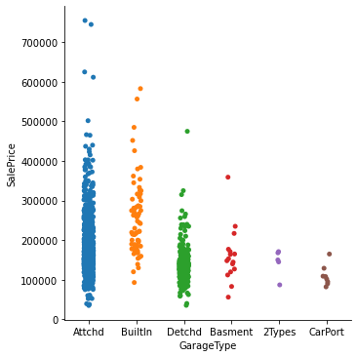

Slide 14
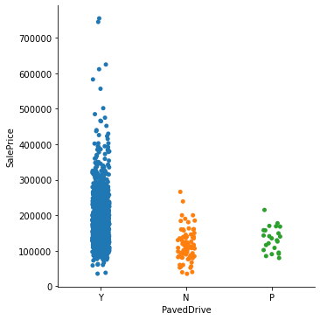
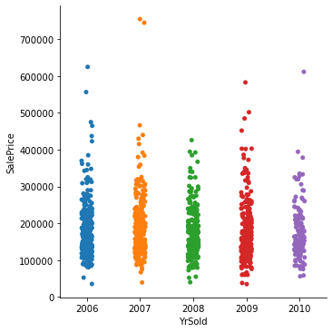

Slide 15
DATA ANALYSIS
I used box plots to find which features have outliers in them and then I used Z-score method to reduce the number of outliers
After checking the skewness, I tried to reduce the skewness from the features using PowerTransformer
I then encoded the categorical data using LabelEncoder
Scaled the data so that the data is uniform and the model does not perform in a biased manner
After which I checked for multicolinearity, but did not find any multicolinearity problem

Slide 16
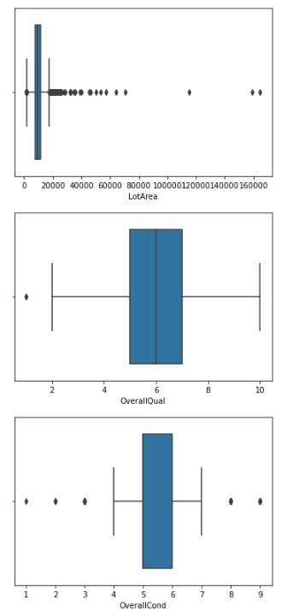
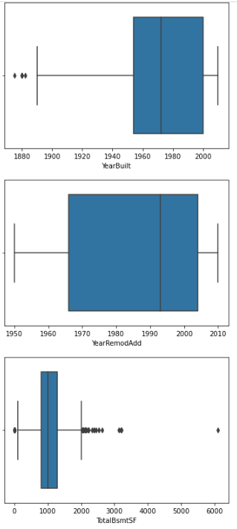
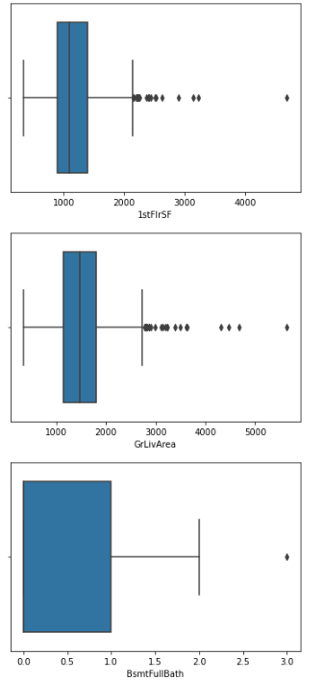

Slide 17
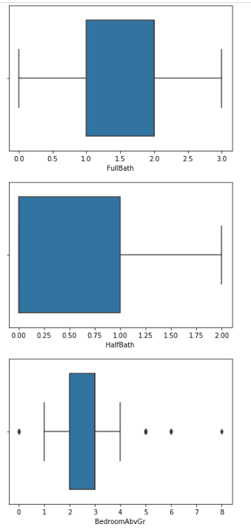
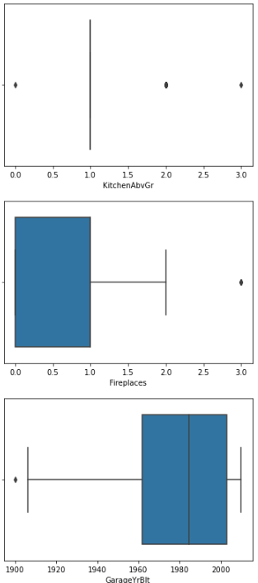
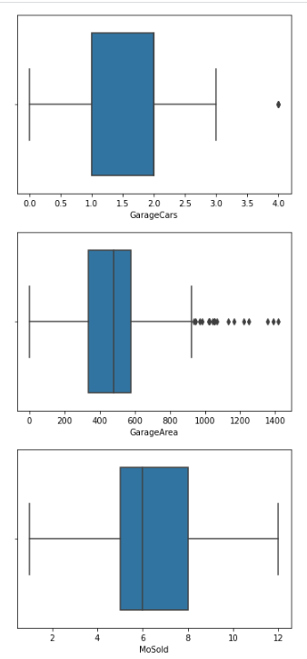

Slide 18
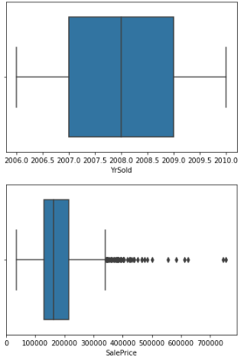
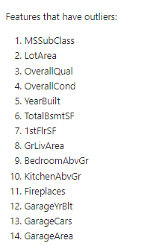

Slide 19
MODEL BUILDING
Since the problem is to predict the price of the houses I have used Regression algorithm's to do the prediction
I this project I have used the following algorithm’s
Linear Regression
Random Forest Regression
Decision Tree Regression
AdaBoost Regresion
GradientBoost Regression
ExtraTrees Regression
XGBoost Regression

Slide 20
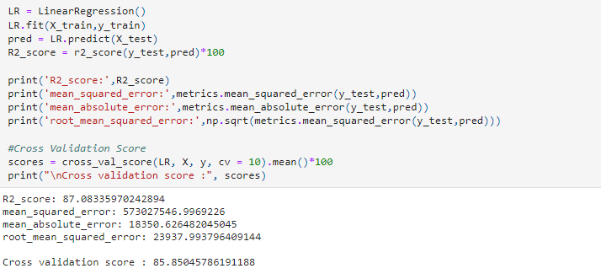
LINEAR REGRESSION

Slide 21
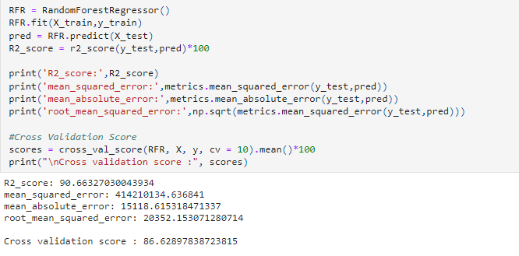
RANDOM FOREST REGRESSION

Slide 22
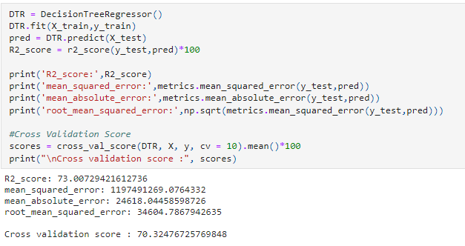
DECISION TREE REGRESSION

Slide 23
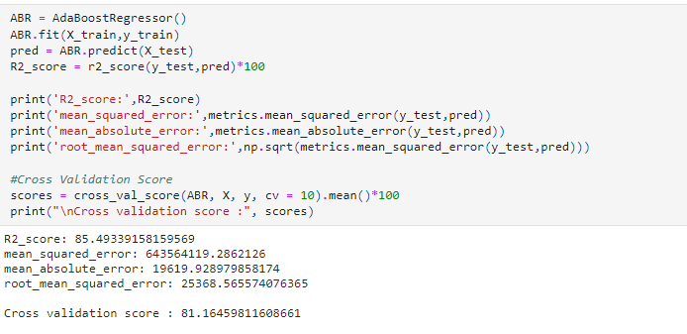
ADABOOST REGRESSION

Slide 24
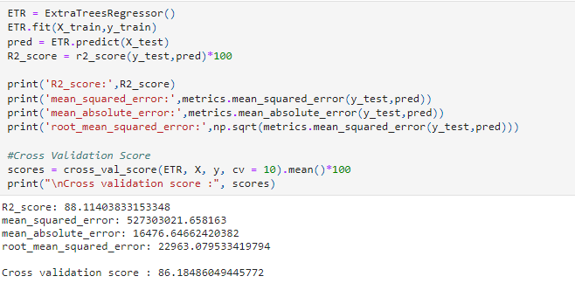
EXTRA TREES REGRESSION

Slide 25
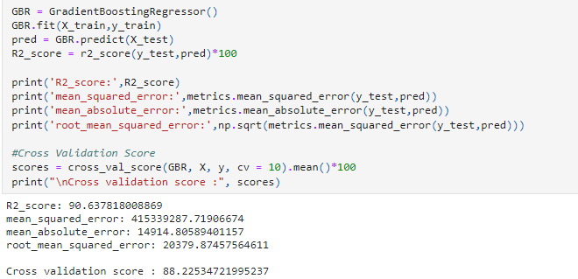
GRADIENT BOOSTING REGRESSION

Slide 26
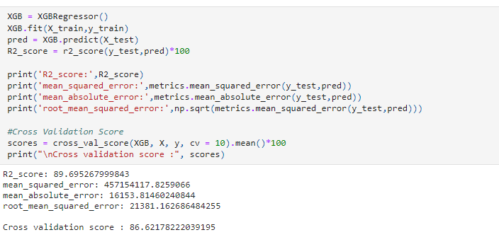
XG BOOST REGRESSION

Slide 27

SAVING THE MODEL
I have saved the model using pickle

Slide 28
CONCLUSION
In this project I tried to show how the house prices vary and what are the factors related to the changes in the house prices. The best accuracy score was achieved by stacking our top 5 fine-tuned models.
After building the models, I found out that Linear Regression model gave us the best accuracy score
Finally, we predicted the Sale Price for the test dataset using the Linear regression model

